Slide 1
@@TO$$
PREPARED BY WARNER & SPENCER

Slide 2
Introduction
@@in$$

Slide 3








@@PS1T$$
@@PS1$$
problem
List 3-5 problems your company observes and wants to solve.
@@PS2T$$
@@PS2$$

Slide 4

@@S1t$$
@@S1$$
Solution
@@S2t$$
List 3-5 ways your company proposes to solve them.
@@S2$$

Slide 5


product
of service
@@B1$$

Slide 6


@@MO1t$$
@@MO1$$
@@MO2t$$
@@MO2$$
MARKET
OPPURTUNITIES
@@MO3t$$
@@MO3$$

Slide 7
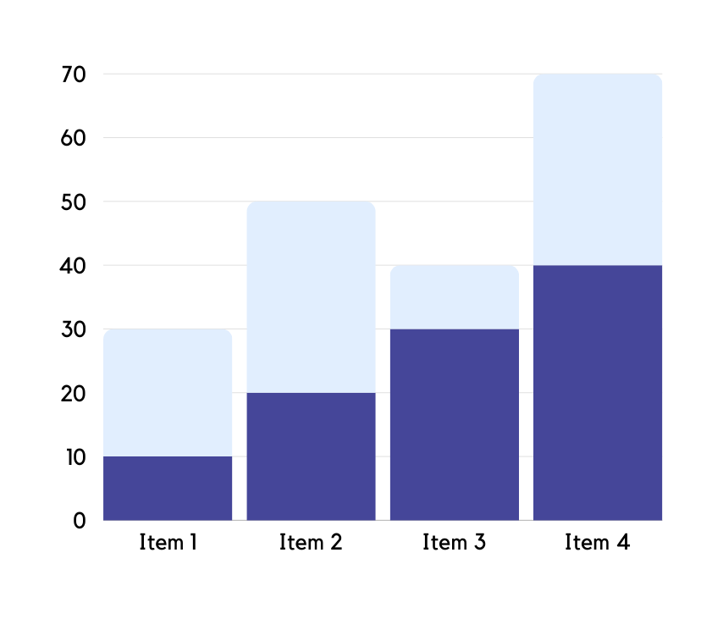
traction
Where is your company currently at? Visualize with a graph to highlight important developments.

Slide 8



2.1 Billion
size the
Total Available
Market (TAM)
market
29 M
Serviceable Available
Market (SAM)
9.4M
Apply the two ways to size the market - top down or bottom up.
Serviceable Obtainable
Market (SOM)

Slide 9



THE
team
@@T1$$
@@T2$$
Say something nice about your team.
@@T3$$

Slide 10

ADDRESS
contacts
@@AD$$
EMAIL
We will be very pleased to work with you on future projects.
@@CD$$

